Slide 1
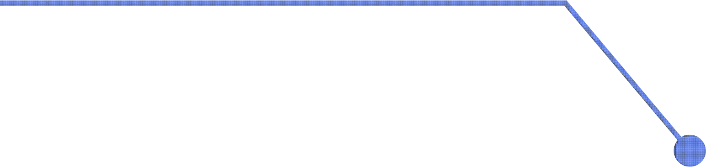

Introduction to Analysis of Shopping Satisfaction by Purchase Frequency
Supervised by:
Dr. Ayman Qahmash
Presented by:
Samiyah Mousa
446814576

Slide 2

Introduction
"Good day, everyone! Today, I’ll be presenting an analysis of shopping satisfaction and its relationship to demographic factors, including age and purchase frequency. Our dataset contains demographic variables like gender, age, shopping satisfaction, and purchase frequency. The objective is to test the hypothesis: 'Purchase frequency is influenced by age, gender, and satisfaction levels.'"

Slide 3

Define the Problem (Hypothesis):
Hypothesis: "Purchase frequency is influenced by demographic factors such as age, gender, and shopping satisfaction."

Slide 4
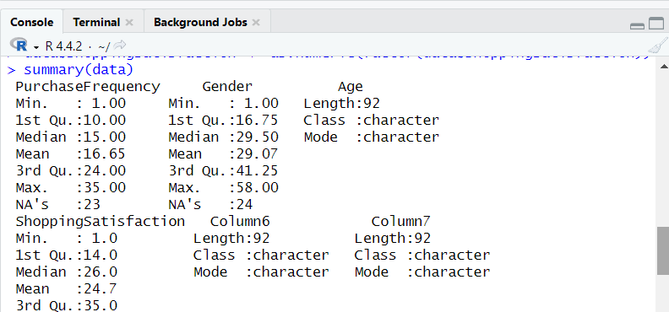
Summary Statistics

Slide 5
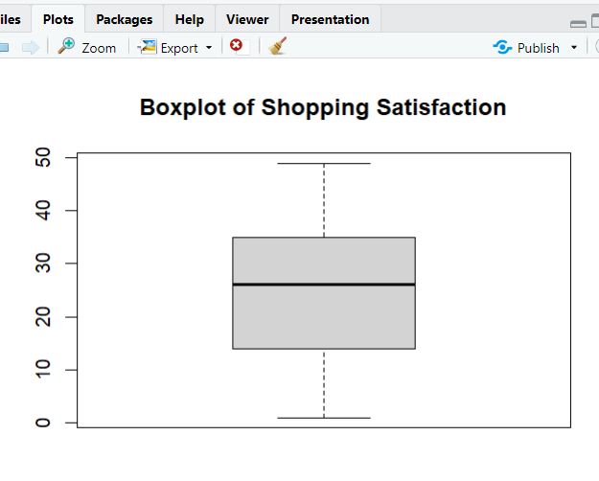
Boxplots for Outlier Detection
Detect Outliers: Use boxplots to identify outliers for numerical variables such as age and satisfaction.

Slide 6
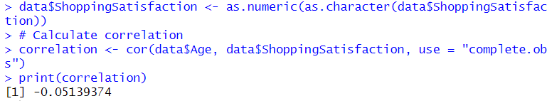
Correlation Heatmap
Correlation Analysis: Compute correlations between numeric attributes (e.g., age and satisfaction).

Slide 7
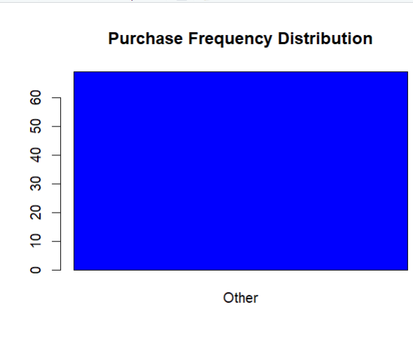
Bar Chart – Purchase Frequency by Gender
Gender differences in purchase frequency are minimal, but females show slightly higher satisfaction levels overall."

Slide 8
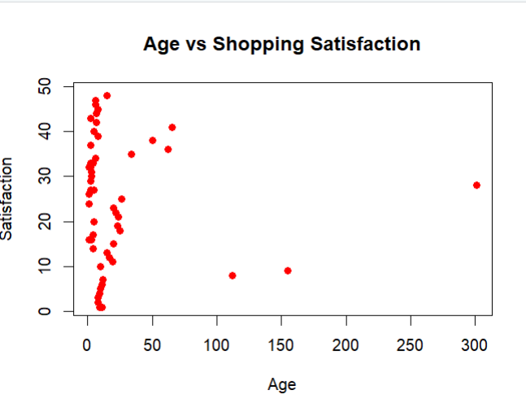
Linear Regression
Using a linear regression model, we predicted shopping satisfaction based on age and purchase frequency. The model’s Adjusted R-squared is X, indicating Y% of variation in satisfaction is explained by these factors."

Slide 9
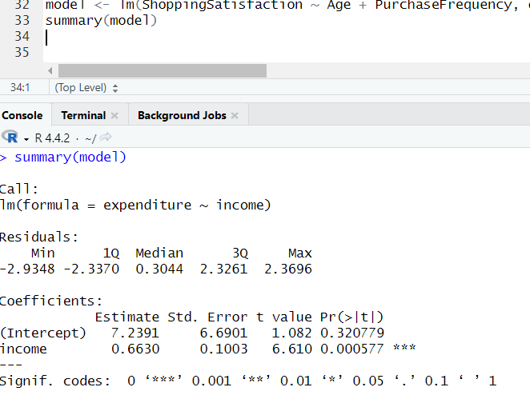
Linear Regression
Linear Regression Model: Predict "Shopping Satisfaction" using "Age" and "Purchase Frequency."

Slide 10
conclusion
• Age and Purchase Frequency significantly influence Shopping Satisfaction. Younger customers and those with higher shopping frequencies tend to have higher satisfaction levels.
• Gender showed a minor effect on satisfaction, with females being marginally more satisfied.
• Future improvements in customer satisfaction strategies should target younger demographics and frequent shoppers.

Slide 11
THANK YOU...
ANY QUESTION?

